Slide 1
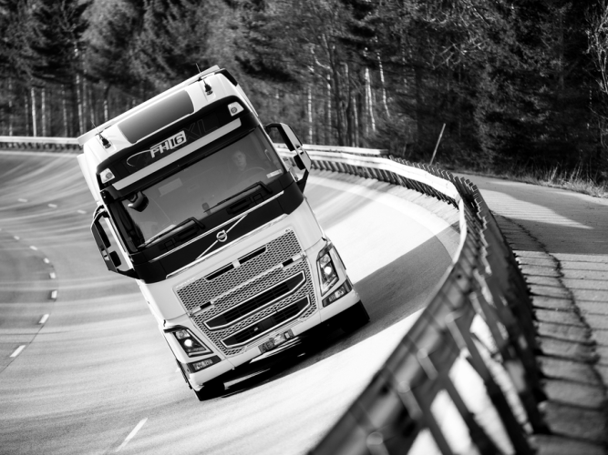
Features, Verification & Validation
FVV is responsible for defining measurable customer requirements in early project phases, as well as working together with Engineering to break down customer features at both system and module levels. We also manage validation plans to reach requested feature level and customer satisfaction. Furthermore, FVV manages verification plans in partnership with engineering teams, and provides optimized and world-class tools such as calculations, rigs, dynos, proving grounds, and field tests.
Notes:
FVV is responsible for defining measurable customer requirements in early project phases, as well as working together with Engineering to break down customer features at both system and module levels. We also manage validation plans to reach requested feature level and customer satisfaction. Furthermore, FVV manages verification plans in partnership with engineering teams, and provides optimized and world-class tools such as calculations, rigs, dynos, proving grounds, and field tests.
We manage most parts of the testing activites, but bigger part of the virtual verification (simulations) are done by vehicle Engineering and Powertrain Engineering.

Slide 2
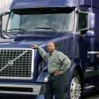
Feature Structure
34 features to describe customers’ satisfaction
Blue managed by FVV
Black Managed by AMT or PD
Grey managed by VE or PE
Quality
& Uptime
Product
Message
1.1 Reliability
1.2 Maintainability
1.3 Durability
1.4 Quality Impression
7.1 Brand identity
7.2 Feature expression
7.3 Aesthetic expression
Transport
Effectiveness
Safety
6.1 Load capacity
6.2 Load handling
6.3 Logistics
6.5 Vehicle agility
6.6 Suitability for bodywork
2.1 Visibility
2.2 Braking
2.3 Handling
2.4 Driver assistance
2.5 Collision safety
2.6 Collision compatibility
2.7 Transportation Security
2.8 Operators Safety & Fire Protection
Driving
Performance
5.1 Fuel economy
5.2 Average Speed
5.3 Driveability
3.1 Driver position
3.2 Driver interface & communication
3.3 Climate
3.4 Interior noise
3.5 Ride comfort & vibrations
3.6 Resting comfort
3.7 Working comfort
3.8 Entry & exit
Environment
Driver
Environment
4.1 Exhaust emissions
4.2 Exterior noise
4.3 Materials & Environmental impacts
Notes:
We have 34 features to describe the customer perspective of the truck. They are organized in 7 feature areas.
This can be seen as product quality in a wide definition.
This structure is owned by PPL on the highest level = the 34-level.
Feature is one of several requirement areas when running a product development project
Other requirement areas are:
Product cost
Manufacturing requirements
....
The Features marked in BLUE are managed by FVV
The Features marked in BLACK are also managed by CV (AMT and PD)
The Features marked in GREY are managed by Vehicle Engineering or Powertrain Engineering

Slide 3
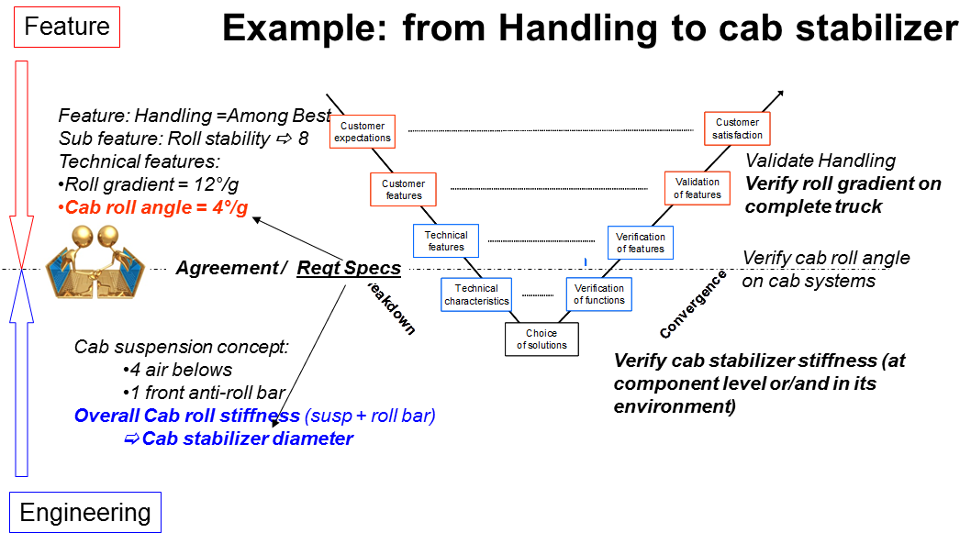
Features, Verification & Validation Activities & Performance
Develop and validate customer features by
Defining measurable customer requirements
Test to learn
Breaking down customer features at both system and module levels
Developing and executing optimized verification and validation plans
Building prototypes for testing
Virtual tools and physical testing
Trucks on test tracks and at selected customers
Utilizing our truck and customer knowledge in close cooperation with our partners

Slide 4
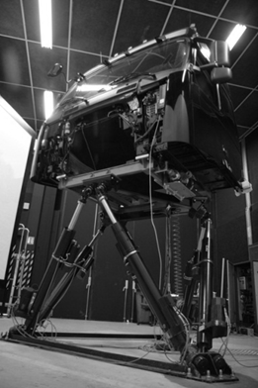
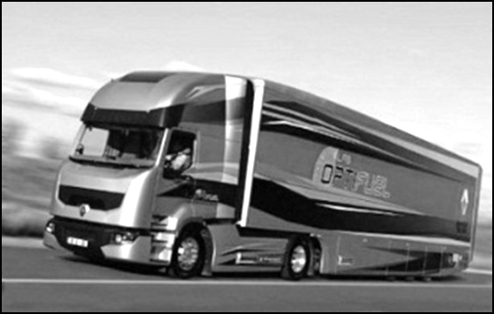
Features, Verification & Validation Activities & Performance - Features
Vehicle and Driver Productivity
Act as reference experts regarding the feature knowledge within the Vehicle and Driver productivity Area
Example of features within the area
Fuel Eco, Logistics, Load Capacity, Interior Noise, Ride Comfort, Braking
Set feature target and deliver the right technical requirements upstream in the projects.
Define measurable customer requirements in early project phases
Perform physical and virtual testing on road or on Chassis dynamometers and other test facilities within the area of responsibility

Slide 5
Features, Verification & Validation Activities & Performance - Features
Durability & Reliability
Durability & Reliability Features
Cab, Chassis and PWT installation Testing:
Climate & Environmental Testing
Measurements of vibration, strain and force

Slide 6
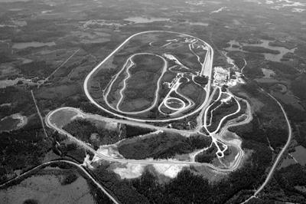
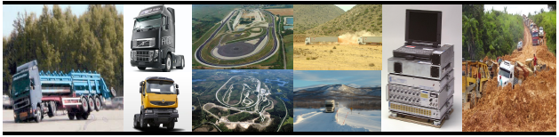
Features, Verification & Validation Activities & Performance
Vehicle Verification & Validation
Verification and validation of complete trucks on test tracks and public roads with internal/external drivers and haulers (IH, RT, AET testing)
Data logging in our different tests, technical support for measurement equipment and calibration
Verification/Validation complete trucks with our customers – Field testing
Verification & Validation of Truck Functionality in complete trucks - PVT

Slide 7
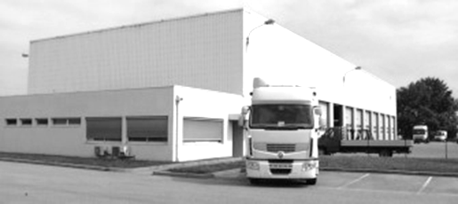
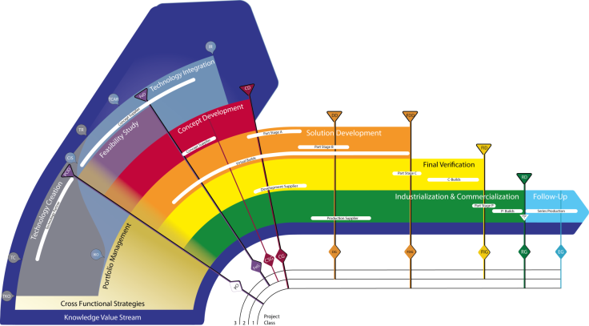
Features, Verification & Validation Activities & Performance
Workshops, Vehicle and Project Management
The Prototype Workshop is a support group which works in three main areas
build and update of test objects (i.e. complete trucks, test rigs..) in cooperation with Product Build, engineering departments our plants and other related units
building cab and cab mock-up for engineering and testing
preparing trucks for testing
The Project Management Office is managing all project deliveries performed by FVV in order to deliver projects with QDCF fulfillment. It Is also optimizing the V&V plans to balance risk, cost and time
Vehicle Fleet and Uptime Management is responsible for optimizing the vehicle fleet in order to fulfill verification & validation requests

Slide 8
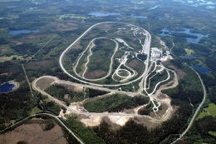
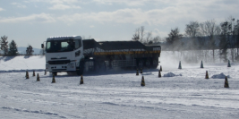
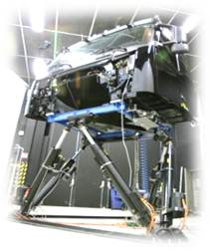
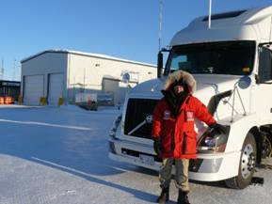
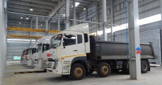
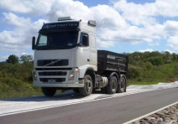
Features, Verification & Validation Global presence & personnel
Gothenburg Hällered PG, ASTA 260 Dynos: VFL + second dyno CAB, Chassis & Axle Shake rigs Vehicle Workshops
Truck Noise Chamber
Ageo Motegi PG 40 Dynos: 2 -> 1
CAB, Chassis & Axle Shake rigs Vehicle Workshop
Lyon La Valbonne PG
140 Dynos: V-track CAB, Chassis Shake rigs Vehicle Workshops
Driving Simulator
Greensboro/ GSO PG - limited Hagerstown Dynos: GSO Dyno
105 CAB, Chassis & Axle Shake rigs Vehicle Workshop
Bangalore Hoskote PG - limited 35 Vehicle Workshop
Curitiba Vehicle Workshop 35 Limited shaker rigs
Notes:
Ths gives an overview of major facilities on a high evel.
Proving grounds will be further explained on coming slides.
Dynos:
The most advanced chassis dyno is in VFL (Vehicle Feature Laboratory) in Gothenburg. This facility has the highest capability in terms of windspeed/temperature and brake power on the rollers. It is also prepared for runing the vehicles on alternative fuels.
CAB, Chassis &Axel Shake rigs (= Durability laboratory):
Gothenburg, Lyon and Greensboro all have well equiped durability labs. In Gothenburg, the boggie shaker rig has unique capabilities.
The durability laboratory in Ageo has a lot of old and simple rigs. However, a 7-poster rig has been updated to modern standard.
In Curitiba we have a very simpe durability lab for single axle component testing.
In Bangalore we buy all durability rig testing from external Indian suppliers or provide service from our european facilities
Outside this mapping of major facilities we have several smaller dedicated rigs for special purposes to differnet extent on the different sites.

Slide 9
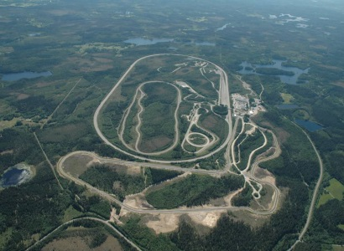

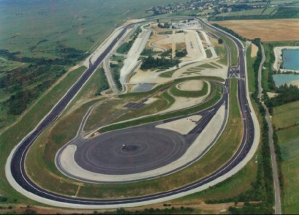
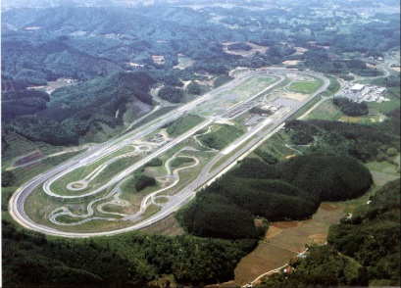
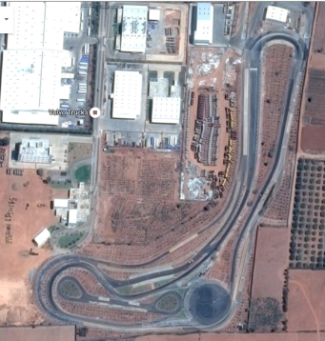
Proving grounds
Kiruna, Cold Climate testing
Hällered PG
Almeria, Hot Climate testing
Greensboro PG
La Valbonne PG
Motegi PG
Bangalore
Curitiba
Curitiba
Notes:
For more details,see next slide

Slide 10
Ownership and agreements
Proving Ground | Ownership | Synergies | Comment
Hällered | Volvo Car Corp. | VCC, Volvo BUS, | Well equipped Adjacent Partner, ASTA
LaValbonne | Volvo Group | IRIS BUS, others | Well equipped Cooperation Partner TRANSPOLIS
Greensboro | Volvo Group |  | Not fully equipped Use also other test tracks in US
Allentown | Closed | - | -
Motegi | Nissan Motors | Nissan Motors, JATCO | Well equipped Rental agreement including pre-buy option negotiated with Nissan Motors
Bangalore Hoskote | Volvo Group | Group synergies with Hoskote plant | Mainly Durability Use also other test tracks in India, distance is a problem
Curitiba | Randon | Commercial proving ground | Use Randon proving ground, distance is a problem
Kiruna | Swedish Air auth. | VCC, Volvo Bus | Reliability Cold. Workshop, mainly public roads
Almeria | Michelin | Commercial supplier | Reliability Hot, Workshop, mainly public roads

Slide 11











Org. chart for Features, Verification & Validation
Level N-4
(GTT->Complete Vehicle->FVV)
Features, Verification & Validation
Lars Sundberg
Management Coordinator
Global Quality Manager
Maria Siverbo
Tommy Vartia
Operational Efficiency Manager
Magnus Sternbåge
FVV GOT
HD Platform
Global Feature & Function Management
Global Virtual & Physical Testing Technology
Hans-Fredrik Henrysson
Lars Forsman (acting)
Lars Forsman
FVV LYS
M/HMP Platform
Pierre–Alain Makula
FVV AGEO
Olivier Laval
FVV BLR
Kalayil Binoj
FVV NA
Martin Phillips
FVV CUR
Rafael Barreto

